Slide 1
MCP_DSP_FIN
Long Report
By Lily Zhang
07/15/2011

Slide 2
Outline
Introduction
MCP_DSP_FN board’s system block diagram
DSP ( ADSP_BF561 )
Functionalities DSP implemented
Lesson learned

Slide 3
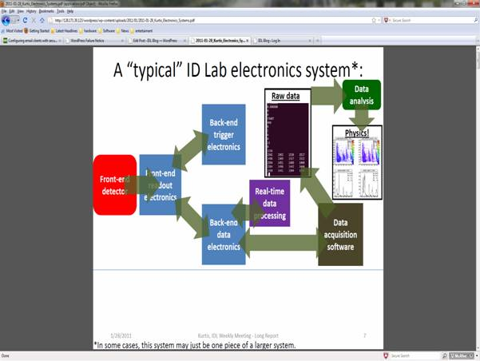
Introduction
A pixel detector or photomultiplier tube
Data analysis and display it
collects data (waveform sampling) and send data (waveform) over fiber optics to “back-end” electronics
Receive data and assemble it, then do data processing and pass results to PC

Slide 4
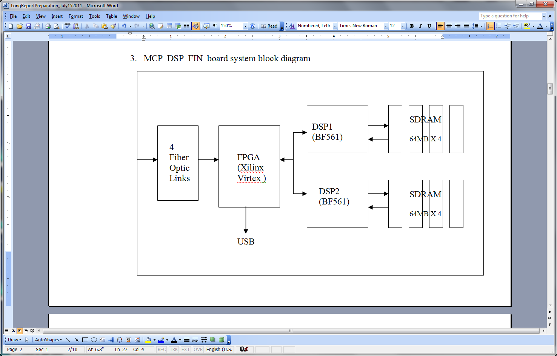
MCP_DSP_FN system block diagram

Slide 5
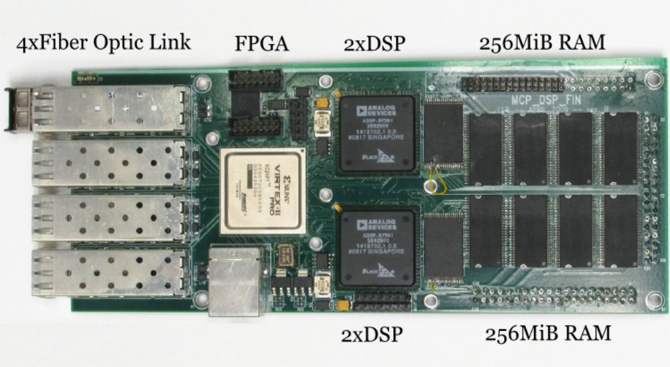
MCP_DSP_FN system block diagram
Hardware Board

Slide 6
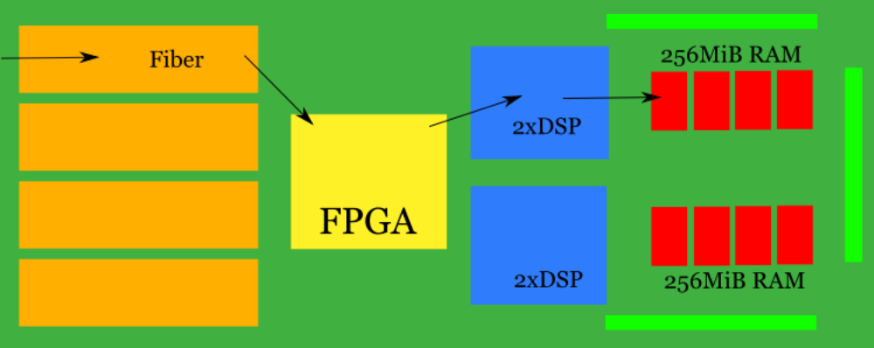
MCP_DSP_FN block diagram

Slide 7
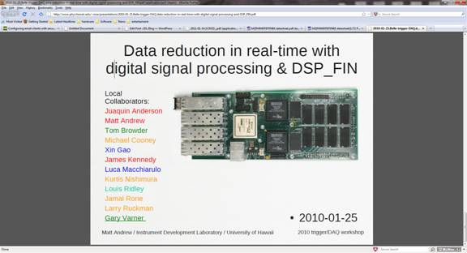
MCP_DSP_FN system block diagram

Slide 8
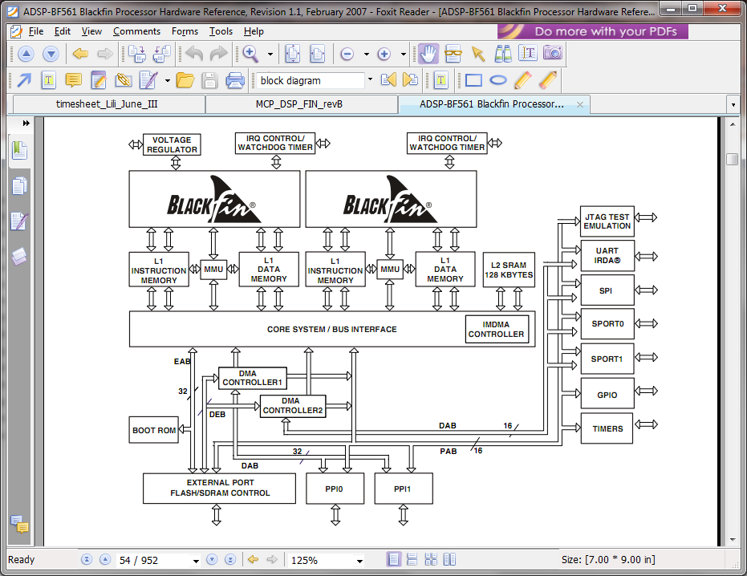
DSP ( ADSP_BF561 )
ADSP_BF561 block diagram

Slide 9
DSP ( ADSP_BF561 )
Cores - The ADSP-BF561 has two identical Blackfin cores
Memory – L1, L2, and L3
  Internal Memory – L1, L2
  External Memory - L3
Please see next the memory mapping diagram

Slide 10
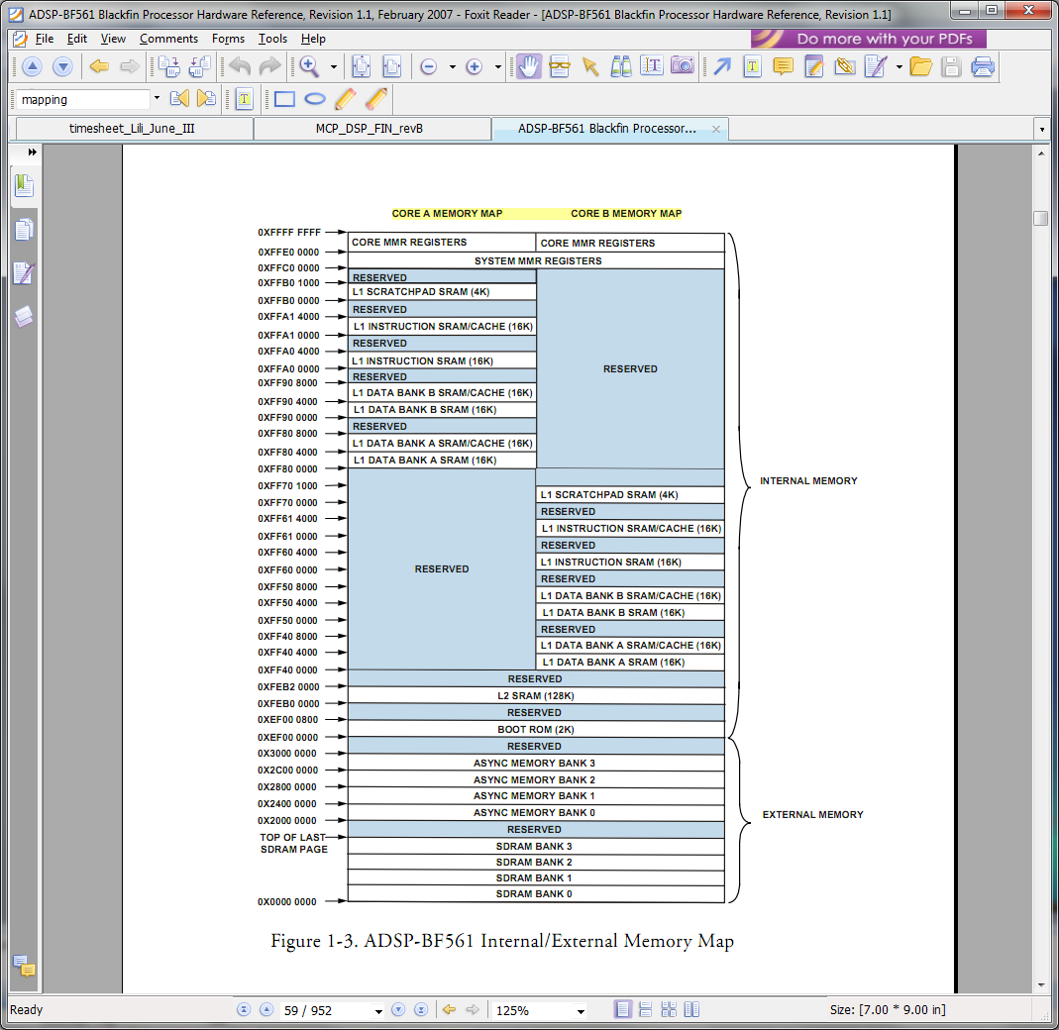
DSP ( ADSP_BF561 )
Memory mapping diagram

Slide 11
DSP ( ADSP_BF561 )
DMA - The ADSP-BF561 has two independent DMA controllers that sup-
port automated data transfers with minimal overhead for the core. (DMA1, DMA2)
PPI - The processor provides two Parallel Peripheral Interfaces (PPI0, PPI1)

Slide 12
DSP ( ADSP_BF561 )
Timers - 12 general purpose programmable timer units
Serial Ports - two dual-channel synchronous serial ports (SPORT0 and SPORT1) for serial and multiprocessor communications
SPI port – (Serial Peripheral Interface Port)
UART port - provides a full-duplex Universal Asynchronous Receiver/Transmitter (UART) port
Programmable flags - 48 bidirectional programmable flag (PF) or general-purpose I/O pins, PF[47:0].

Slide 13
Functionalities DSP implemented
Receiving data from FPGA
All waveforms are received by PPI0 through DMA1 controller channel_0. Waveforms are pulled into SDRAM bank0 first.
DMA operating mode is descriptor list (larger)
Clock of PPI0 (75MHz) is provided by FPGA and Frame Sync signal is also provide by FPGA.
After each waveform is received, an interrupt is generated to manage the waveform count.

Slide 14
Functionalities DSP implemented
Real-time data processing
Pedestal subtraction (pedestal value obtained from calibration)
Time-base correction – spline and splint algorithms

Slide 15
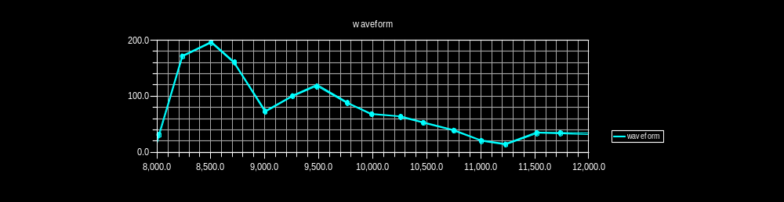
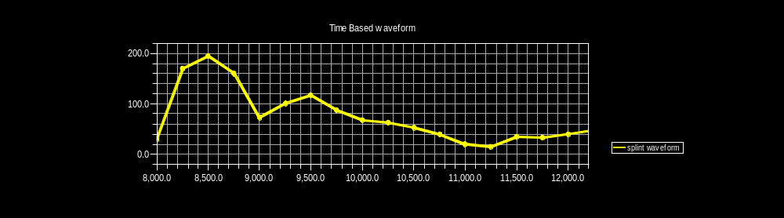
Functionalities DSP implemented

Slide 16
Functionalities DSP implemented
Real-time data processing
Do Fast –Fourier Transform (FFT)
  As you all know that FFT is an efficient algorithm and it converts data from time domain to frequency domain. i.e. FFT generates the frequency spectrum for a time domain waveform.
  If value is too small, it needs to multiply some numbers.

Slide 17
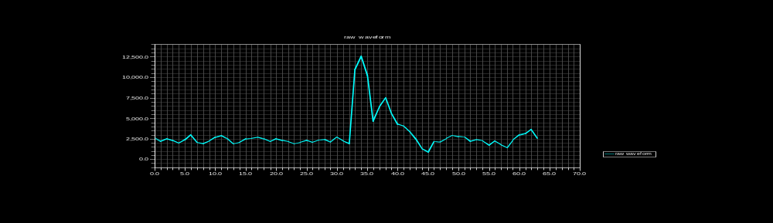
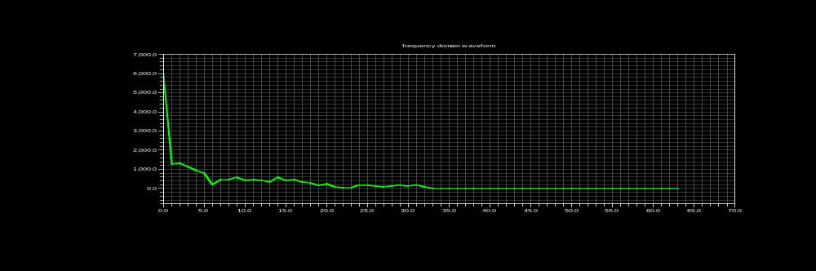
Functionalities DSP implemented
Real-time data processing - FFT

Slide 18
Functionalities DSP implemented
Real-time data processing - IFFT
Apply filter (Now we have no information about filter yet.) .
  This part will be completed in the future when the information is ready.
IFFT - Inverse Fast Fourier Transform
Convert frequency domain waveform data back to time domain waveform for further analysis.

Slide 19
Functionalities DSP implemented
Real-time data processing - Q
Calculate integration value (Q) - calculate the area of waveform. There are many inter-middle steps involved.
Calculate the pulse leading edge time (trig time) -- 20% of max value

Slide 20
Functionalities DSP implemented
Sending data back to FPGA
When all results are ready, it is packed into SDRAM bank1. It will be sent out by PPI1 through DMA1 controller channel 2.
DMA operating mode is STOP mode. When the current work unit completes, the DMA channel stops automatically.
After the data is sent out, an interrupt is generated to manage the counts and disable PPI1.
Frame Sync signal FS1 is obtained from Timer10. If we use internal Frame sync signal, PPI clock is too high with value 75MHz. (PPIclk =< fSCLK/2)

Slide 21
Lesson Learned
Some valuable information might located in an different document – search and read carefully
Use all sources analog device provided
  Video tutorial
  Engineering notes for many different problems
  Tech support
Talk to people to get advice or suggestions
Use simple case to debug if it is stuck in somewhere
It can be frustrated during the design sometime. That is normal. Don’t give up.

Slide 22


